Slide 1
Week 4 – Government Intervention in Markets (Price Controls, Taxes, Subsidies)
EC1101E, NUS, Spring 2020. Week 4. Guillem Riambau

Slide 2
Plan for today
Recap from last day
Government intervention
Taxes & Subsidies
Quotas
Price limits
EC1101E, NUS, Spring 2020. Week 4. Guillem Riambau

Slide 3
Reminder
Midterm Exam: Thursday, March 12. 6.30-8.30p.m, at LT34 (Faculty of Science, near the bus stop), e-Exam
Friday February 14: ExamSoft demo with IT staff
EC1101E, NUS, Spring 2020. Week 4. Guillem Riambau

Slide 4
KAHOOT
https://play.kahoot.it/v2/?quizId=f694ff84-1d78-4822-8f00-b510aa597940 (Link here)
EC1101E, NUS, Spring 2020. Week 4. Guillem Riambau

Slide 5
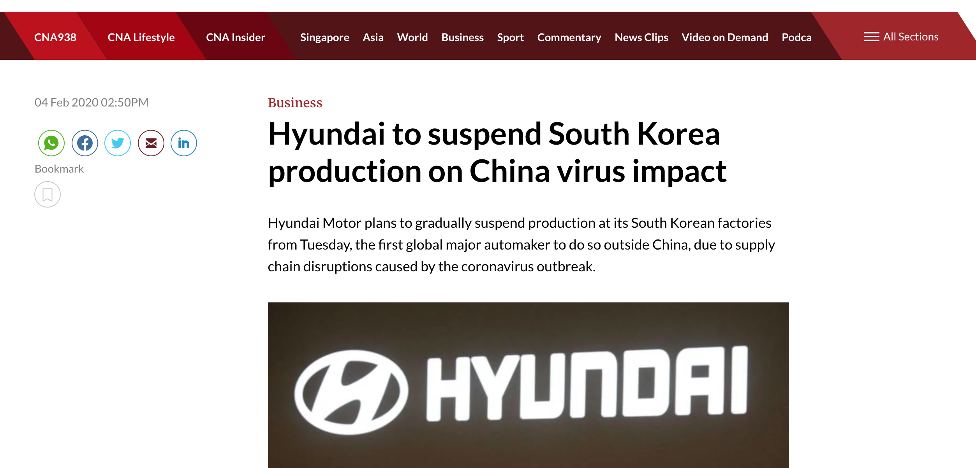
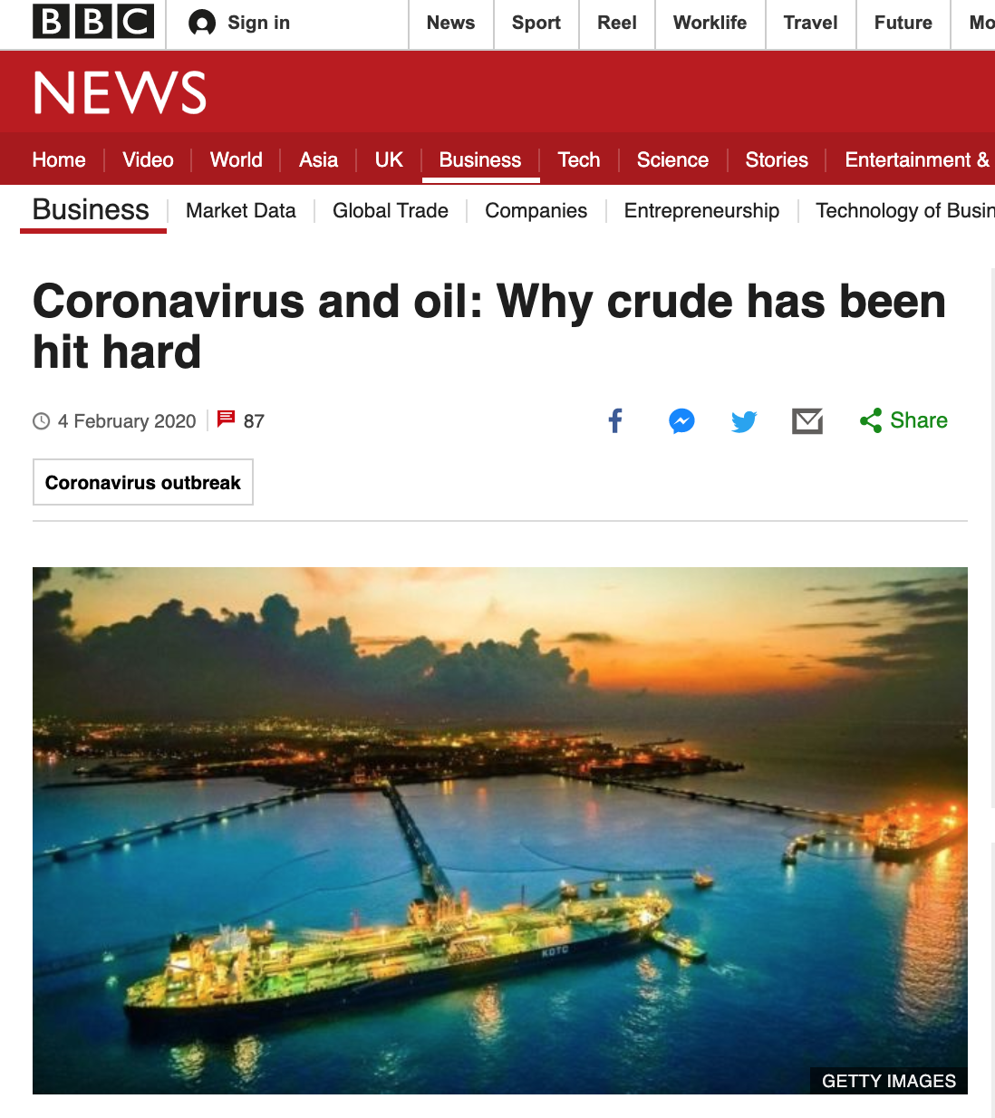
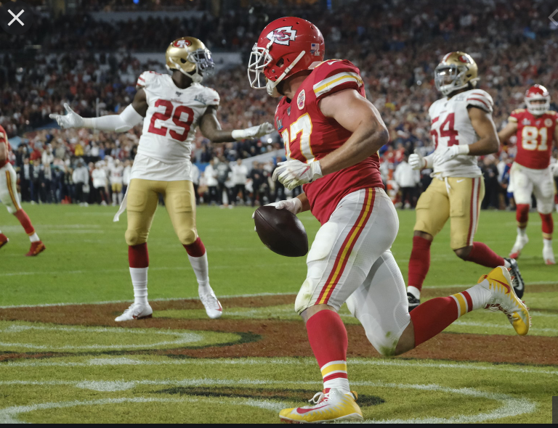
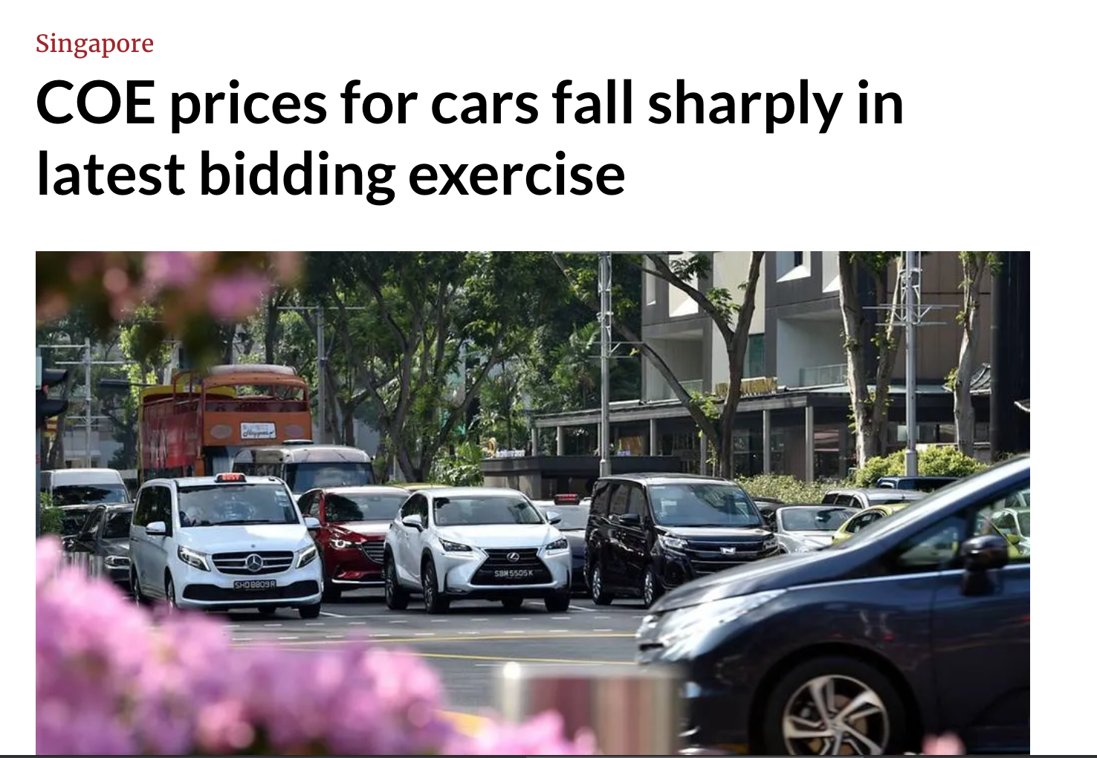
Recap from last day
EC1101E, NUS, Spring 2020. Week 4. Guillem Riambau

Slide 6
Hyundai
EC1101E, NUS, Spring 2020. Week 4. Guillem Riambau

Slide 7
Market for cars
Price
Q
EC1101E, NUS, Spring 2020. Week 4. Guillem Riambau

Slide 8
Market for cars
Price
S₀
D₀
Q
EC1101E, NUS, Spring 2020. Week 4. Guillem Riambau

Slide 9
Market for cars
Price
S₁
S₀
D₀=D₁
Q
EC1101E, NUS, Spring 2020. Week 4. Guillem Riambau

Slide 10
Market for cars
Price
S₁
S₀
Slowdown in markets car markets: p , q
D₀=D₁
Q
EC1101E, NUS, Spring 2020. Week 4. Guillem Riambau

Slide 11
COE
EC1101E, NUS, Spring 2020. Week 4. Guillem Riambau

Slide 12
COE Singapore
Price
S₀
D₀
Q
EC1101E, NUS, Spring 2020. Week 4. Guillem Riambau

Slide 13
COE Singapore
Price
S₀
Which curve has been affected? How?
D₀
Q
EC1101E, NUS, Spring 2020. Week 4. Guillem Riambau

Slide 14
COE Singapore
Price
S₁=S₀
D₀
D₁
Q
EC1101E, NUS, Spring 2020. Week 4. Guillem Riambau

Slide 15
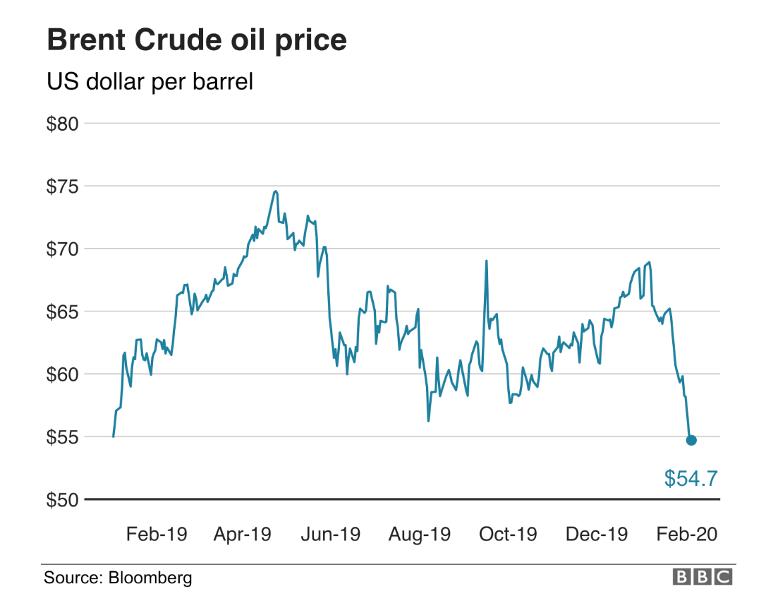
OIL
Link here.
EC1101E, NUS, Spring 2020. Week 4. Guillem Riambau

Slide 16
OIL
Price
S₀
Which curve has been affected? How?
D₀
Q
EC1101E, NUS, Spring 2020. Week 4. Guillem Riambau

Slide 17
OIL
Price
S₀
Which curve has been affected? How?
D₀
D₁
Q
EC1101E, NUS, Spring 2020. Week 4. Guillem Riambau

Slide 18
OIL
Price
p , q
S₀
D₀
D₁
Q
EC1101E, NUS, Spring 2020. Week 4. Guillem Riambau

Slide 19
OIL
Price
p , q
S₀
What may oil exporters do to increase price?
D₀
D₁
Q
EC1101E, NUS, Spring 2020. Week 4. Guillem Riambau

Slide 20
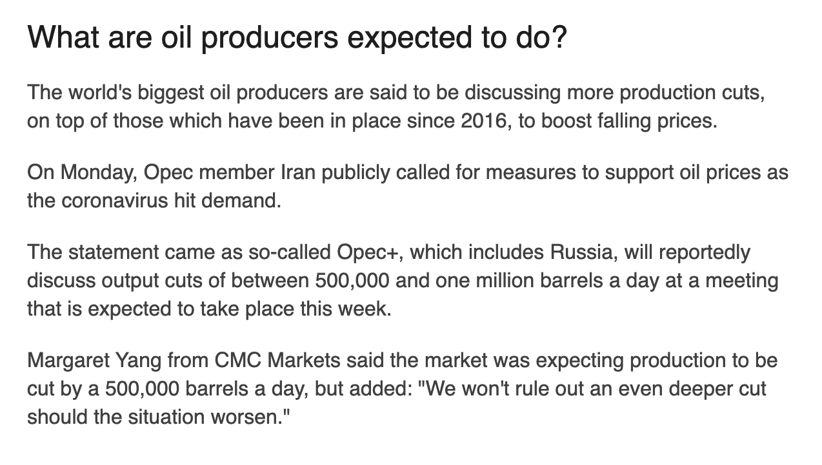
OIL
p , q
S₀
What may oil exporters do to increase price?
D₀
D₁
Q
EC1101E, NUS, Spring 2020. Week 4. Guillem Riambau

Slide 21
OIL
Price
S₁
p , q
S₀
Price back to initial price, but quantity much smaller
D₀
D₁
Q
EC1101E, NUS, Spring 2020. Week 4. Guillem Riambau

Slide 22
OIL
Price
S₁
p , q
S₀
Price back to initial price, but quantity much smaller
D₀
D₁
Q
EC1101E, NUS, Spring 2020. Week 4. Guillem Riambau

Slide 23
SUPERBOWL ADS
https://www.youtube.com/watch?v=2zfqw8nhUwA (MAC 1984)
https://www.youtube.com/watch?v=wY3xa1X6zHY (COCA-COLA 1980)
https://www.dailymotion.com/video/x7rekj0 (COCA-COLA 2020)
https://www.dailymotion.com/video/x7rdpby (Quibi 2020)
EC1101E, NUS, Spring 2020. Week 4. Guillem Riambau

Slide 24
SUPERBOWL ADS
Why has price increased over the years?but quantity much smaller
EC1101E, NUS, Spring 2020. Week 4. Guillem Riambau

Slide 25
SUPERBOWL ADS: why have they become so expensive?
Price
S₁₉₈₀
D₁₉₈₀
Q (time)
EC1101E, NUS, Spring 2020. Week 4. Guillem Riambau

Slide 26
SUPERBOWL ADS: why have they become so expensive?
Price
S₁₉₈₀₌S₂₀₂₀
D₂₀₂₀
D₁₉₈₀
Q (time)
EC1101E, NUS, Spring 2020. Week 4. Guillem Riambau

Slide 27
Today: Problems? Solutions!
Road congestion
Gambling addiction
Alcohol abuse
Sugar-y foods over-consumption
Sedentarism
Lack of art spaces
Hawker culture in peril
Etc.
EC1101E, NUS, Spring 2020. Week 4. Guillem Riambau

Slide 28
Today: Other government goals
Promote connectivity of all firms and citizens
Increase human capital and cultural knowledge
Decrease anxiety of high-school students
Promote car/grab sharing
Etc.
EC1101E, NUS, Spring 2020. Week 4. Guillem Riambau

Slide 29
What are the government tools?
EC1101E, NUS, Spring 2020. Week 4. Guillem Riambau

Slide 30
What are the government tools?
Taxes & Subsidies
On consumers
On sellers
EC1101E, NUS, Spring 2020. Week 4. Guillem Riambau

Slide 31
What are the government tools?
Taxes & Subsidies
On consumers
On sellers
Price limits
Price floor
Price ceiling
EC1101E, NUS, Spring 2020. Week 4. Guillem Riambau

Slide 32
What are the government tools?
Taxes & Subsidies
On consumers
On sellers
Price limits
Price floor
Price ceiling
Quantity limits: quota
EC1101E, NUS, Spring 2020. Week 4. Guillem Riambau

Slide 33
What can the government do?
Link to PUB web here: https://www.pub.gov.sg/watersupply/waterprice
EC1101E, NUS, Spring 2020. Week 4. Guillem Riambau

Slide 34
What can the government do?
Link to PUB web here: https://www.pub.gov.sg/watersupply/waterprice
EC1101E, NUS, Spring 2020. Week 4. Guillem Riambau

Slide 35
What can the government do?
Too much water consumption
Government goal is to reduce it
What can be done?
EC1101E, NUS, Spring 2020. Week 4. Guillem Riambau

Slide 36
What can the government do?
One option: taxes on consumers
EC1101E, NUS, Spring 2020. Week 4. Guillem Riambau

Slide 37
What can the government do?
One option: taxes on consumers
To simplify: taxing one dollar per unit consumed
For every unit, pay before tax price $x, and pay $1 as tax
EC1101E, NUS, Spring 2020. Week 4. Guillem Riambau

Slide 38
Taxing consumers: before tax
Price
S
$5
D
Q
20
EC1101E, NUS, Spring 2020. Week 4. Guillem Riambau

Slide 39
Taxing consumers: after tax
Price
S
$1
$5
$1
D_{at}
D_{bt}
Q
20
EC1101E, NUS, Spring 2020. Week 4. Guillem Riambau

Slide 40
Taxing consumers: after tax
Price
S
$1
Consumers willing to pay sellers $5 for 20 units before
$5
$4
$1
D_{at}
D_{bt}
Q
20
EC1101E, NUS, Spring 2020. Week 4. Guillem Riambau

Slide 41
Taxing consumers: after tax
Price
S
$1
Consumers willing to pay sellers $5 for 20 units before
Now: Willing to pay sellers $4, and government $1
$5
$4
$1
D_{at}
D_{bt}
Q
20
EC1101E, NUS, Spring 2020. Week 4. Guillem Riambau

Slide 42
Taxing consumers: after tax
Price
S
$1
Hence, vertical distance is $1
$5
$4
$1
D_{at}
D_{bt}
Q
20
EC1101E, NUS, Spring 2020. Week 4. Guillem Riambau

Slide 43
Taxing consumers: after tax
Price
S
$1
To suppliers, what matters is the new demand
because that’s the money they see
$5
$4
$1
D_{at}
D_{bt}
Q
20
EC1101E, NUS, Spring 2020. Week 4. Guillem Riambau

Slide 44
Taxing consumers: after tax
Price
S
$1
What’s the new equilibrium?
$5
$4
$1
D_{at}
D_{bt}
Q
20
EC1101E, NUS, Spring 2020. Week 4. Guillem Riambau

Slide 45
Taxing consumers: after tax
Price
S
$1
What’s the new equilibrium?
$5
$4
$1
D_{at}
D_{bt}
Q
20
EC1101E, NUS, Spring 2020. Week 4. Guillem Riambau

Slide 46
Taxing consumers: after tax
Price
S
$1
What’s the new equilibrium?
$4.5
$1
D_{at}
D_{bt}
Q
18
EC1101E, NUS, Spring 2020. Week 4. Guillem Riambau

Slide 47
Taxing consumers: after tax
Price
S
$1
$5.5
Buyers pay this
$4.5
$1
D_{at}
D_{bt}
Q
18
EC1101E, NUS, Spring 2020. Week 4. Guillem Riambau

Slide 48
Taxing consumers: after tax
Price
S
$1
$5.5
$4.5
Sellers get this
$1
D_{at}
D_{bt}
Q
18
EC1101E, NUS, Spring 2020. Week 4. Guillem Riambau

Slide 49
Taxing consumers: after tax
Price
S
$1
$5.5
Government gets this
$4.5
$1
D_{at}
D_{bt}
Q
18
EC1101E, NUS, Spring 2020. Week 4. Guillem Riambau

Slide 50
Taxing consumers: after tax
Price
S
$1
Buyers pay $5.5
Sellers get $4.5
Government gets $1
$5.5
$4.5
$1
D_{at}
D_{bt}
Q
18
EC1101E, NUS, Spring 2020. Week 4. Guillem Riambau

Slide 51
Taxing consumers: after tax
Price
S
$1
 | Before | After | Change
Consumers | $5 | $5.5 | +0.5
Sellers | $5 | $4.5 | -0.5
Government | - | $1 | +1
$5.5
$4.5
$1
D_{at}
D_{bt}
Q
18
EC1101E, NUS, Spring 2020. Week 4. Guillem Riambau

Slide 52
Taxing $1 per unit to consumers
 | Before | After | Change
Consumers | $5 | $5.5 | +0.5
Sellers | $5 | $4.5 | -0.5
Government | - | $1 | +1
Consumers bear half the burden (+$0.5)
Sellers bear half the burden (-$0.5)
EC1101E, NUS, Spring 2020. Week 4. Guillem Riambau

Slide 53
Taxing $1 per unit to consumers
 | Before | After | Change
Consumers | $5 | $5.5 | +0.5
Sellers | $5 | $4.5 | -0.5
Government | - | $1 | +1
Consumers bear half the burden (+$0.5)
Sellers bear half the burden (-$0.5)
Less water consumed ✔
Nominally paying the tax is irrelevant. What matters is who effectively ”suffers” it. More on this soon.
EC1101E, NUS, Spring 2020. Week 4. Guillem Riambau

Slide 54
Welfare analysis
 | Before | After | Change
Consumers | $5 | $5.5 | +0.5
Sellers | $5 | $4.5 | -0.5
Government | - | $1 | +1
Who wins? Who loses? Is there any social loss?
EC1101E, NUS, Spring 2020. Week 4. Guillem Riambau

Slide 55
Let’s compare welfare before and after tax
Price
S
D_{at}
D_{bt}
Q
EC1101E, NUS, Spring 2020. Week 4. Guillem Riambau

Slide 56
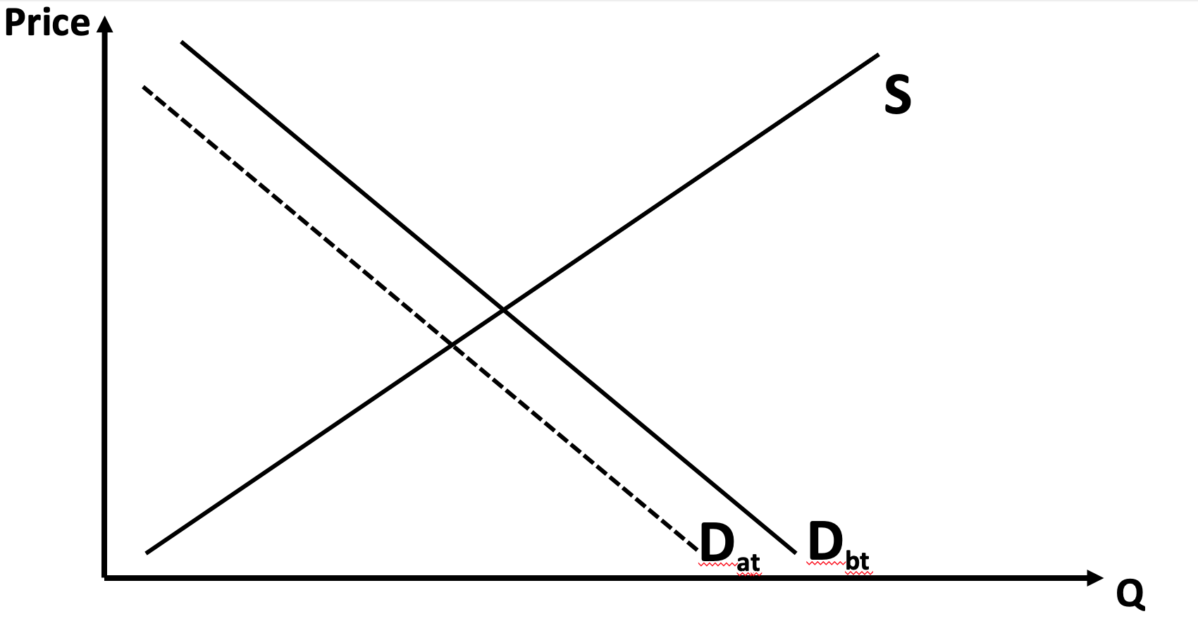
Let’s compare welfare before and after tax
Before
After
EC1101E, NUS, Spring 2020. Week 4. Guillem Riambau

Slide 57
Let’s compare welfare before and after tax
Before
After
CS
PS
EC1101E, NUS, Spring 2020. Week 4. Guillem Riambau

Slide 58
Let’s compare welfare before and after tax
Before
After
CS
PS
EC1101E, NUS, Spring 2020. Week 4. Guillem Riambau

Slide 59
Let’s compare welfare before and after tax
Before
After
CS
CS
PS
EC1101E, NUS, Spring 2020. Week 4. Guillem Riambau

Slide 60
Let’s compare welfare before and after tax
Before
After
CS
CS
PS
EC1101E, NUS, Spring 2020. Week 4. Guillem Riambau

Slide 61
Let’s compare welfare before and after tax
Before
After
CS
CS
PS
EC1101E, NUS, Spring 2020. Week 4. Guillem Riambau

Slide 62
Let’s compare welfare before and after tax
Before
After
CS
CS
PS
PS
EC1101E, NUS, Spring 2020. Week 4. Guillem Riambau

Slide 63
Let’s compare welfare before and after tax
Before
After
CS
CS
PS
PS
EC1101E, NUS, Spring 2020. Week 4. Guillem Riambau

Slide 64
Let’s compare welfare before and after tax
Before
After
CS
CS
Tax revenue
PS
PS
EC1101E, NUS, Spring 2020. Week 4. Guillem Riambau

Slide 65
Let’s compare welfare before and after tax
Before
After
CS
CS
Tax revenue
Deadweight Loss
PS
PS
EC1101E, NUS, Spring 2020. Week 4. Guillem Riambau

Slide 66
Let’s compare welfare before and after tax
Before
After
CS
CS
Tax revenue
Deadweight Loss
PS
PS
EC1101E, NUS, Spring 2020. Week 4. Guillem Riambau

Slide 67
Taxing $1 per unit to consumers
 | Before | After | Change
Consumers | $5 | $5.5 | +0.5
Sellers | $5 | $4.5 | -0.5
Government | - | $1 | +1
Similar losses in surplus for both
Nominally paying the tax is irrelevant. What matters is who effectively ”suffers” it. Elasticities are key here.
EC1101E, NUS, Spring 2020. Week 4. Guillem Riambau

Slide 68
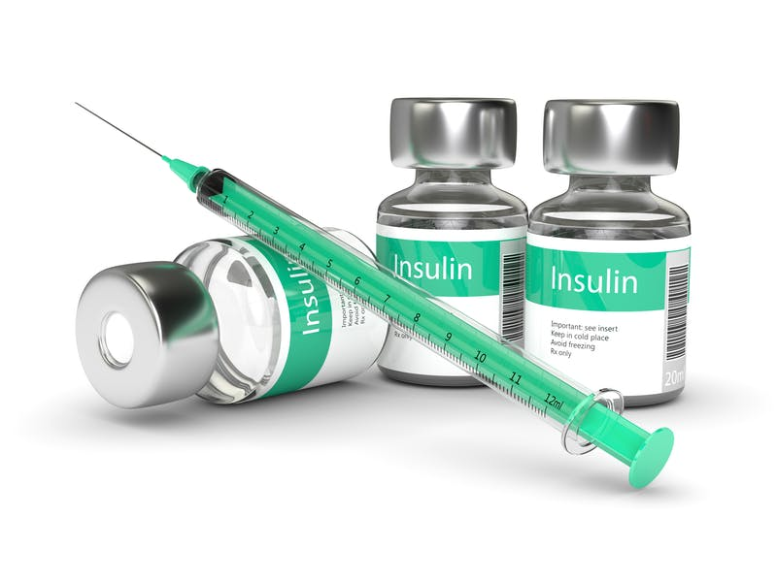
Taxing insulin sellers $1 per unit (before tax)
Price
S
$50
D
100
EC1101E, NUS, Spring 2020. Week 4. Guillem Riambau

Slide 69
Taxing insulin sellers $1 per unit (before tax)
Price
S
$50
D
Q
100
EC1101E, NUS, Spring 2020. Week 4. Guillem Riambau

Slide 70
Taxing insulin sellers $1 per unit (before tax)
This is like an increase in input cost
At any given quantity, sellers want to be paid as before +$1 dollar
Shifts supply to the left (vertical distance: one dollar)
EC1101E, NUS, Spring 2020. Week 4. Guillem Riambau

Slide 71
Taxing insulin sellers $1 per unit (after tax)
Price
S
To sell 100 units, now sellers want to be paid $51:
- $50 for them
- $1 for the government
$50
D
Q
100
EC1101E, NUS, Spring 2020. Week 4. Guillem Riambau

Slide 72
Taxing insulin sellers $1 per unit (after tax)
Price
S
$1
To sell 100 units, now sellers want to be paid $51:
- $50 for them
- $1 for the government
$50
D
Q
100
EC1101E, NUS, Spring 2020. Week 4. Guillem Riambau

Slide 73
Taxing insulin sellers $1 per unit (after tax)
S_{at}
Price
S_{bt}
$1
To sell 100 units, now sellers want to be paid $51:
- $50 for them
- $1 for the government
$51
$50
D
Q
100
EC1101E, NUS, Spring 2020. Week 4. Guillem Riambau

Slide 74
Taxing insulin sellers $1 per unit (after tax)
S_{at}
Price
S_{bt}
$1
To sell 100 units, now sellers want to be paid $51:
- $50 for them
- $1 for the government
$51
$50
D
Q
100
EC1101E, NUS, Spring 2020. Week 4. Guillem Riambau

Slide 75
Taxing insulin sellers $1 per unit (after tax)
S_{at}
Price
S_{bt}
$1
$51
What is the new equilibrium after tax?
$50
D
Q
100
EC1101E, NUS, Spring 2020. Week 4. Guillem Riambau

Slide 76
Taxing insulin sellers $1 per unit (after tax)
S_{at}
Price
S_{bt}
$1
$50.9
Consumers pay $50.9
D
95
Q
EC1101E, NUS, Spring 2020. Week 4. Guillem Riambau

Slide 77
Taxing insulin sellers $1 per unit (after tax)
S_{at}
Price
S_{bt}
$1
$50.9
Consumers pay $50.9
How much do sellers get?
D
95
Q
EC1101E, NUS, Spring 2020. Week 4. Guillem Riambau

Slide 78
Taxing insulin sellers $1 per unit (after tax)
S_{at}
Price
S_{bt}
$1
$50.9
Consumers pay $50.9
How much do sellers get?
$50.9 - $1 tax = $40.9
D
95
Q
EC1101E, NUS, Spring 2020. Week 4. Guillem Riambau

Slide 79
Taxing insulin sellers $1 per unit (after tax)
S_{at}
Price
S_{bt}
$1
$50.9
Consumers pay $50.9
How much do sellers get?
$50.9 - $1 tax = $49.9
$49.9
D
95
Q
EC1101E, NUS, Spring 2020. Week 4. Guillem Riambau

Slide 80
Taxing insulin sellers $1 per unit (after tax)
S_{at}
Price
S_{bt}
$1
$50.9
Consumers pay $50.9
How much do sellers get?
$50.9 - $1 tax = $49.9
Who bears the burden of the tax?
$49.9
D
95
Q
EC1101E, NUS, Spring 2020. Week 4. Guillem Riambau

Slide 81
Taxing insulin sellers $1 per unit (after tax)
S_{at}
Price
S_{bt}
$1
Consumers pay $50.9
How much do sellers get?
$50.9 - $1 tax = $49.9
Who bears the burden of the tax?
$50.9
$50
$49.9
D
95
Q
EC1101E, NUS, Spring 2020. Week 4. Guillem Riambau

Slide 82
Taxing insulin sellers $1 per unit (after tax)
S_{at}
Price
S_{bt}
$1
$50.9
$50
$49.9
D
95
Q
EC1101E, NUS, Spring 2020. Week 4. Guillem Riambau

Slide 83
Taxing insulin sellers $1 per unit (after tax)
S_{at}
Price
S_{bt}
Burden for consumers ($0.9)
$1
$50.9
$50
$49.9
Burden for sellers ($0.1)
D
95
Q
EC1101E, NUS, Spring 2020. Week 4. Guillem Riambau

Slide 84
Taxing insulin sellers $1 per unit (after tax)
S_{at}
Price
S_{bt}
Burden for consumers ($0.9)
$1
$50.9
$50
$49.9
Burden for sellers ($0.1)
 | Before | After | Change
Consumers | $50 | $50.9 | +0.9
Sellers | $50 | $49.9 | -0.1
Government | - | $1 | +1
D
95
Q
EC1101E, NUS, Spring 2020. Week 4. Guillem Riambau

Slide 85
Taxing insulin sellers $1 per unit (after tax)
 | Before | After | Change
Consumers | $50 | $50.9 | +0.9
Sellers | $50 | $49.9 | -0.1
Government | - | $1 | +1
Consumers bear most of the burden (+$0.9)
Sellers bears a very small burden (-$0.1)
Why? Demand is more inelastic
Nominally paying the tax is irrelevant. Sellers can transfer the tax to consumers.
EC1101E, NUS, Spring 2020. Week 4. Guillem Riambau

Slide 86
Let’s compare welfare before and after tax
Price
S’
S
D
Q
EC1101E, NUS, Spring 2020. Week 4. Guillem Riambau

Slide 87
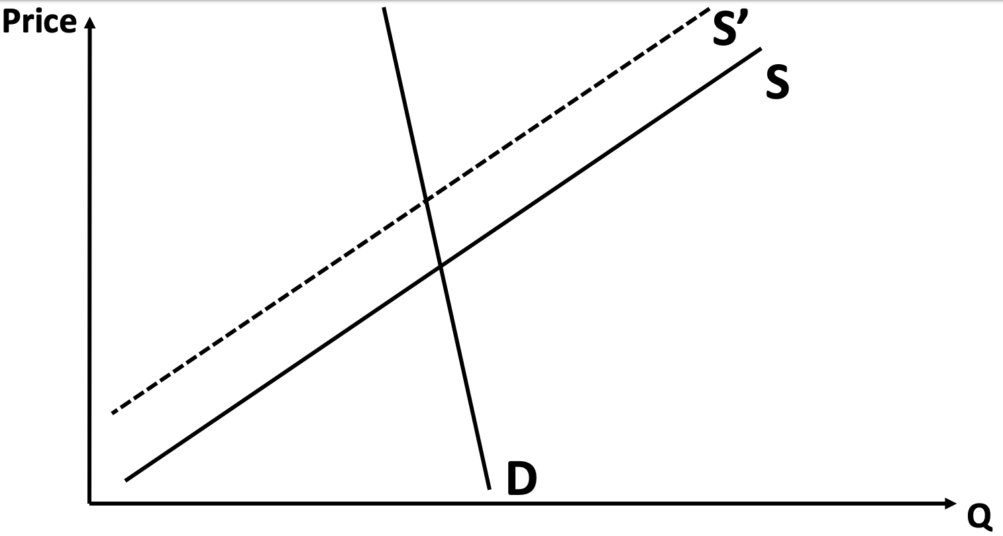
Let’s compare welfare before and after tax
Before
After

Slide 88
Let’s compare welfare before and after tax
Before
After

Slide 89
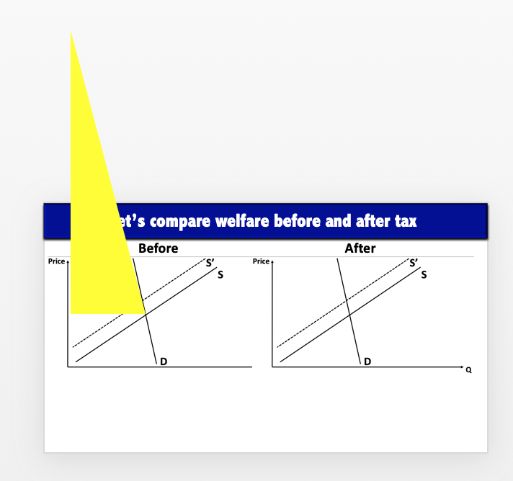
Let’s compare welfare before and after tax
Before
After

Slide 90
Let’s compare welfare before and after tax
Before
After
CS
PS

Slide 91
Let’s compare welfare before and after tax
Before
After
CS
CS
PS

Slide 92
Let’s compare welfare before and after tax
Before
After
CS
CS
PS
PS

Slide 93
Let’s compare welfare before and after tax
Before
After
CS
CS
Tax revenue
PS
PS

Slide 94
Let’s compare welfare before and after tax
Before
After
CS
CS
Tax revenue
Deadweight Loss
PS
PS

Slide 95
Let’s compare welfare before and after tax
Before
After
CS
CS
Tax revenue
Deadweight Loss
PS
PS

Slide 96
Welfare before and after tax
Demand relatively more inelastic than supply
Consumers bear most of the burden
Consumers’ welfare loss > Sellers’ welfare loss
Supply relatively more inelastic than demand
Sellers bear most of the burden
Sellers’ welfare loss > Consumers’ welfare loss
Who nominally pays for the tax is irrelevant

Slide 97
Welfare before and after tax
Demand relatively more inelastic than supply
Consumers bear most of the burden
Consumers’ welfare loss > Sellers’ welfare loss
Supply relatively more inelastic than demand
Sellers bear most of the burden
Sellers’ welfare loss > Consumers’ welfare loss
Who nominally pays for the tax is irrelevant

Slide 98
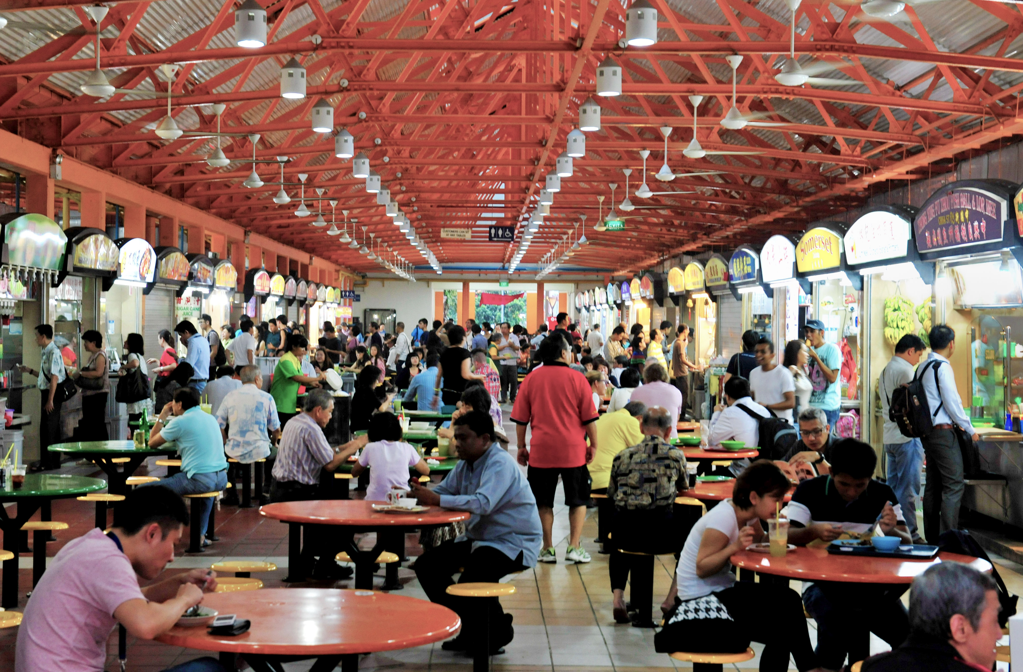
Helping out the hawker culture

Slide 99
Helping out the hawker culture
Subsidize hawker stalls: $ for each unit sold
As you can imagine, subsidizing stalls will have the same effect as subsidizing consumers
Next: graphical analysis

Slide 100
Helping out the hawker culture
Price
S
$5
D
Q
200
EC1101E, NUS, Spring 2020. Week 4. Guillem Riambau

Slide 101
Helping out the hawker culture
Subsidy: $2 for each unit sold
How does this affect supply?
Before: “to sell unit 200th, I want $5 from consumers”
After: “to sell unit 200th, I want $3 from consumers”

Slide 102
Helping out the hawker culture
Price
S
S’
$2
$5
$3
D
Q
200
EC1101E, NUS, Spring 2020. Week 4. Guillem Riambau

Slide 103
Helping out the hawker culture
Price
S
S’
This is the supply curve “in the eyes” of consumers
$2
$5
$3
D
Q
200
EC1101E, NUS, Spring 2020. Week 4. Guillem Riambau

Slide 104
Helping out the hawker culture
Price
S
S’
$7
This is the supply curve “in the eyes” of consumers
$2
$5
D
Q
300
EC1101E, NUS, Spring 2020. Week 4. Guillem Riambau

Slide 105
Helping out the hawker culture
What is the new equilibrium?
Who is most benefited, sellers or consumers?

Slide 106
Helping out the hawker culture
Price
S
S’
$2
$5.75
$5
$3.75
D
Q
225
200
EC1101E, NUS, Spring 2020. Week 4. Guillem Riambau

Slide 107
Helping out the hawker culture
Price
S
S’
$2
$5.75
Price stalls receive
$5
$3.75
Price consumers pay
D
Q
225
200
EC1101E, NUS, Spring 2020. Week 4. Guillem Riambau

Slide 108
Helping out the hawker culture
Price
S
S’
$2
$5.75
Price stalls receive
Gain sellers
$5
Gain consumers
Price consumers pay
$3.75
D
Q
200
225
EC1101E, NUS, Spring 2020. Week 4. Guillem Riambau

Slide 109
Helping out the hawker culture
How about welfare gains?
Consumer, Producer, Total Surplus

Slide 110
Helping out the hawker culture
Price
S
S’
D
Q
EC1101E, NUS, Spring 2020. Week 4. Guillem Riambau

Slide 111
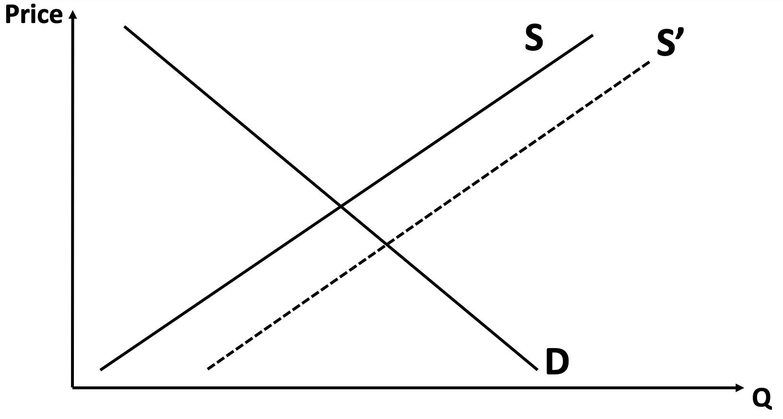
Helping out the hawker culture
Before subsidy
After subsidy
EC1101E, NUS, Spring 2020. Week 4. Guillem Riambau

Slide 112
Helping out the hawker culture
Before subsidy
After subsidy
CS
EC1101E, NUS, Spring 2020. Week 4. Guillem Riambau

Slide 113
Helping out the hawker culture
Before subsidy
After subsidy
CS
PS
EC1101E, NUS, Spring 2020. Week 4. Guillem Riambau

Slide 114
Helping out the hawker culture
Before subsidy
After subsidy
CS
PS
EC1101E, NUS, Spring 2020. Week 4. Guillem Riambau

Slide 115
Helping out the hawker culture
Before subsidy
After subsidy
CS
CS
PS
EC1101E, NUS, Spring 2020. Week 4. Guillem Riambau

Slide 116
Helping out the hawker culture
Before subsidy
After subsidy
CS
CS
PS
PS
EC1101E, NUS, Spring 2020. Week 4. Guillem Riambau

Slide 117
Helping out the hawker culture
Before subsidy
After subsidy
CS
CS
PS
PS
EC1101E, NUS, Spring 2020. Week 4. Guillem Riambau

Slide 118
Helping out the hawker culture
Before subsidy
After subsidy
CS
CS
Gov. expenditure
PS
PS
EC1101E, NUS, Spring 2020. Week 4. Guillem Riambau

Slide 119
Helping out the hawker culture
Before subsidy
After subsidy
CS
CS
Gov. expenditure
Deadweight Loss
PS
PS
EC1101E, NUS, Spring 2020. Week 4. Guillem Riambau

Slide 120
Comparing Surplus before and after
Before subsidy
After subsidy
CS
CS
Gov. expenditure
Deadweight Loss
PS
PS
EC1101E, NUS, Spring 2020. Week 4. Guillem Riambau

Slide 121
Comparing Surplus before and after
Before subsidy
After subsidy
CS
CS
Deadweight Loss
PS
PS
EC1101E, NUS, Spring 2020. Week 4. Guillem Riambau

Slide 122
Comparing Surplus before and after
Before subsidy
After subsidy
CS
CS
Deadweight Loss
PS
PS
EC1101E, NUS, Spring 2020. Week 4. Guillem Riambau

Slide 123
Subsidies
Consumers and producers of that good are happier
Socially inefficient: Too much consumed of a given good
Tax payers bear the cost
Subsidies are strategic decisions by governments:

Slide 124
Subsidies
Consumers and producers of that good are happier
Socially inefficient: Too much consumed of a given good
Tax payers bear the cost
Subsidies are strategic decisions by governments:
Protect their culture (hawkers, artists)
Enhance human capital (education)
Protect blue collar jobs (car industry in USA)
Etc. Usually well-motivated political reasons

Slide 125
What can the government do?
Taxes
On consumers
On sellers
Price limits
Price floor
Price ceiling
Quantity limits: quota
EC1101E, NUS, Spring 2020. Week 4. Guillem Riambau

Slide 126
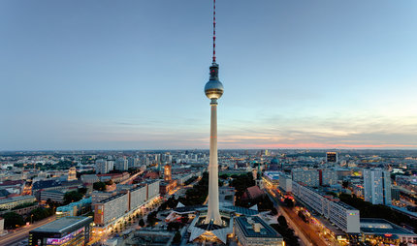
What can the government do?
EC1101E, NUS, Spring 2020. Week 4. Guillem Riambau

Slide 127
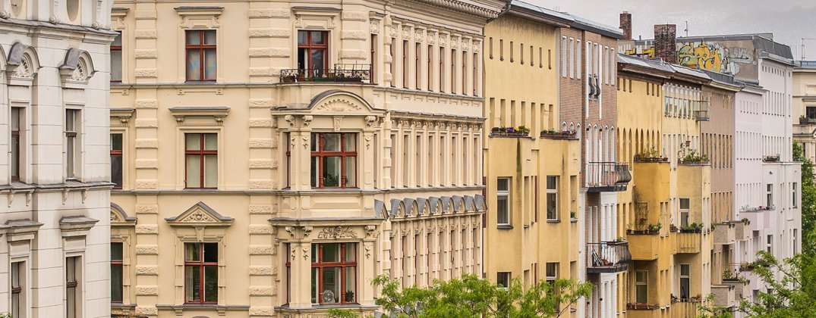
What can the government do?
EC1101E, NUS, Spring 2020. Week 4. Guillem Riambau

Slide 128
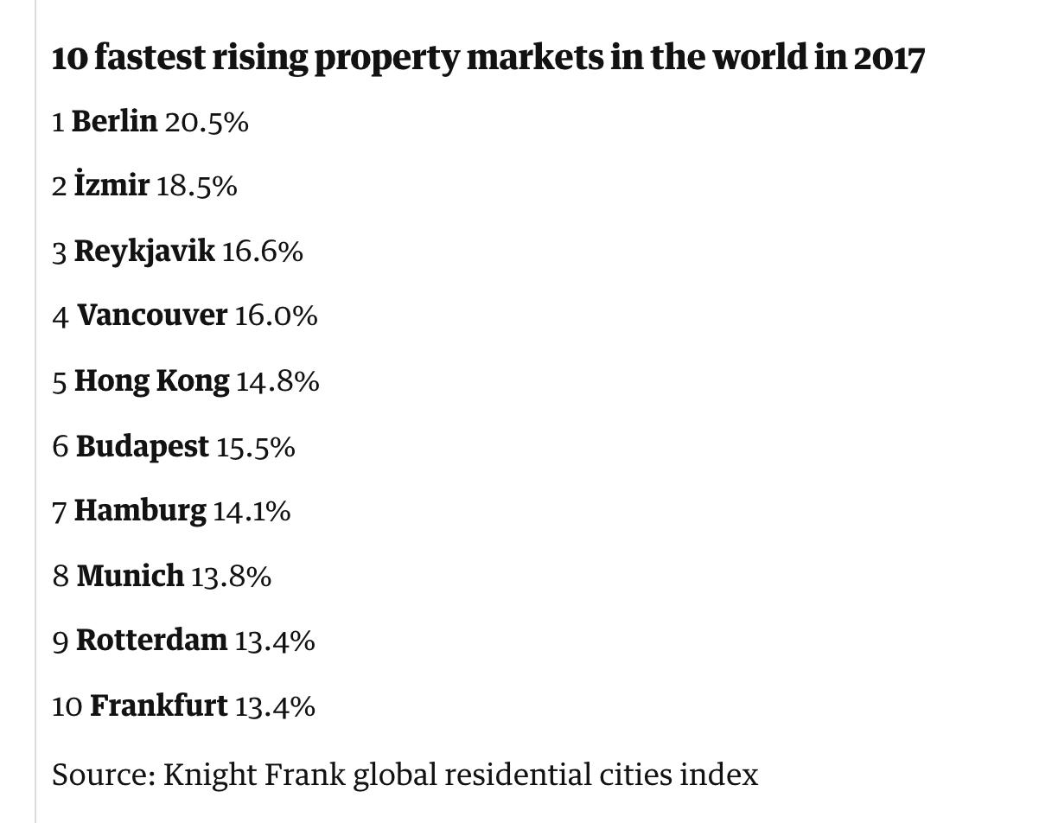
What can the government do?
The Guardian, link here: https://www.theguardian.com/world/2018/apr/10/berlin-world-fastest-rising-property-prices
EC1101E, NUS, Spring 2020. Week 4. Guillem Riambau

Slide 129
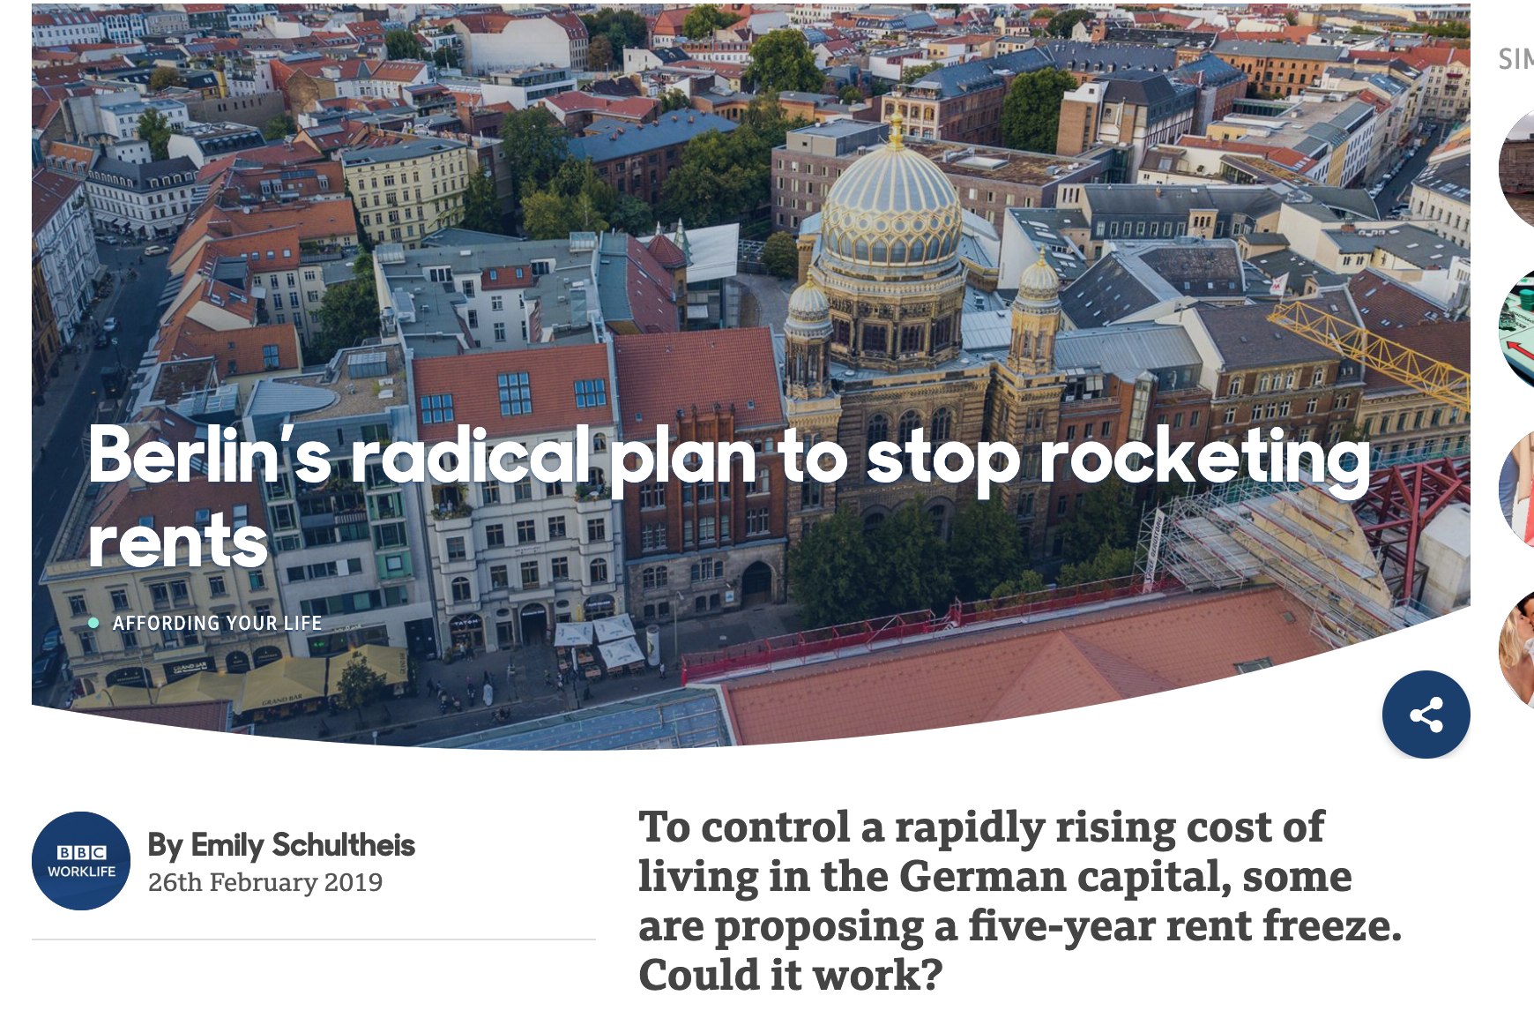
What can the government do?
BBC, link here: https://www.bbc.com/worklife/article/20190226-berlins-radical-plan-to-stop-rocketing-rents
The Guardian, link here: https://www.theguardian.com/world/2018/apr/10/berlin-world-fastest-rising-property-prices
EC1101E, NUS, Spring 2020. Week 4. Guillem Riambau

Slide 130
Price ceiling
Price
S
$3,000
D
500
Q
EC1101E, NUS, Spring 2020. Week 4. Guillem Riambau

Slide 131
Price ceiling
Price
S
Price ceiling: $3,500
$3,000
D
500
Q
EC1101E, NUS, Spring 2020. Week 4. Guillem Riambau

Slide 132
Price ceiling
Price
S
Price ceiling: $3,500
$3,500
$3,000
D
500
Q
EC1101E, NUS, Spring 2020. Week 4. Guillem Riambau

Slide 133
Price ceiling
Price
S
Price ceiling: $3,500
Not binding → nothing happens
$3,500
$3,000
D
500
Q
EC1101E, NUS, Spring 2020. Week 4. Guillem Riambau

Slide 134
Price ceiling
Price
S
$3,000
D
500
Q
EC1101E, NUS, Spring 2020. Week 4. Guillem Riambau

Slide 135
Price ceiling
Price
S
Price ceiling: $2,500
$3,000
D
500
Q
EC1101E, NUS, Spring 2020. Week 4. Guillem Riambau

Slide 136
Price ceiling
Price
S
Price ceiling: $2,500
$3,000
$2,500
D
500
Q
EC1101E, NUS, Spring 2020. Week 4. Guillem Riambau

Slide 137
Price ceiling
Price
S
Price ceiling: $2,500
Q_{Supplied} < Q_{Demanded}
$3,000
$2,500
D
400
600
Q
500
EC1101E, NUS, Spring 2020. Week 4. Guillem Riambau

Slide 138
Price ceiling
Price
S
Price ceiling: $2,500
Q_{Supplied} < Q_{Demanded}
$3,000
$2,500
Excess demand
D
400
600
Q
500
EC1101E, NUS, Spring 2020. Week 4. Guillem Riambau

Slide 139
Price ceiling
Price
S
Price ceiling: $2,500
Q_{Supplied} < Q_{demanded}
Welfare effects?
$3,000
$2,500
Excess demand
D
400
600
Q
500
EC1101E, NUS, Spring 2020. Week 4. Guillem Riambau

Slide 140
Price ceiling
Price
S
$3,000
$2,500
D
400
600
Q
500
EC1101E, NUS, Spring 2020. Week 4. Guillem Riambau

Slide 141
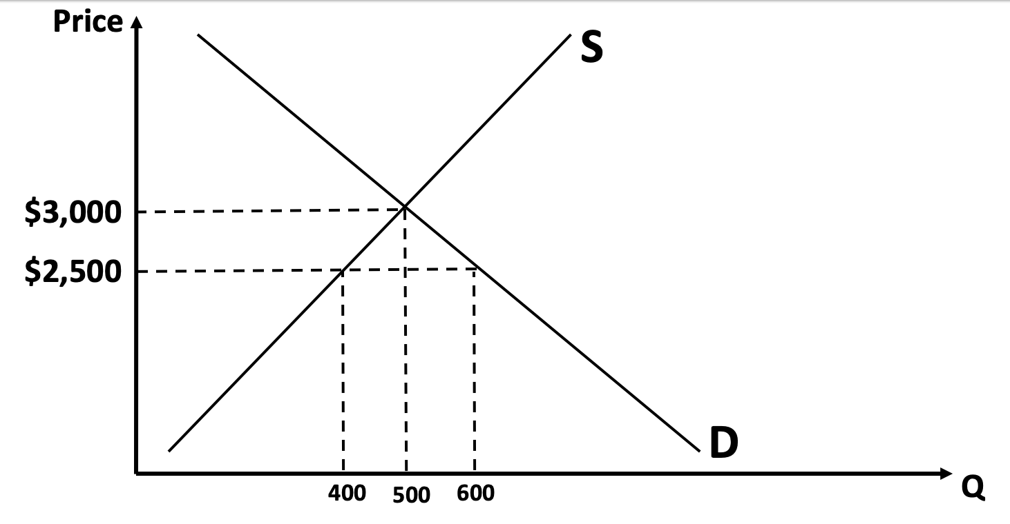
Price ceiling
EC1101E, NUS, Spring 2020. Week 4. Guillem Riambau

Slide 142
Price ceiling
CS
EC1101E, NUS, Spring 2020. Week 4. Guillem Riambau

Slide 143
Price ceiling
CS
PS
EC1101E, NUS, Spring 2020. Week 4. Guillem Riambau

Slide 144
Price ceiling
CS
CS
PS
EC1101E, NUS, Spring 2020. Week 4. Guillem Riambau

Slide 145
Price ceiling
CS
CS
PS
PS
EC1101E, NUS, Spring 2020. Week 4. Guillem Riambau

Slide 146
Price ceiling
CS
CS
Deadweight Loss
PS
PS
EC1101E, NUS, Spring 2020. Week 4. Guillem Riambau

Slide 147
Price ceiling
CS
CS
Deadweight Loss
PS
PS
EC1101E, NUS, Spring 2020. Week 4. Guillem Riambau

Slide 148
Price ceiling
CS
CS
Deadweight Loss
PS
PS
EC1101E, NUS, Spring 2020. Week 4. Guillem Riambau

Slide 149
Price ceiling
Price ceiling
If not binding, no effect
If binding
(SOME) Consumers benefit remarkably
Sellers lose out
Deadweight loss
EC1101E, NUS, Spring 2020. Week 4. Guillem Riambau

Slide 150
Price ceiling
Price ceiling
If not binding, no effect
If binding
(SOME) Consumers benefit remarkably
Sellers lose out
Deadweight loss
Why some? Note that fewer units are sold (or rented out). So fewer consumers get access to apartments now. Those who do get access find it a lot cheaper.
EC1101E, NUS, Spring 2020. Week 4. Guillem Riambau

Slide 151
Price ceiling
Price ceiling
If not binding, no effect
If binding
(SOME) Consumers benefit remarkably
Sellers lose out
Deadweight loss
Some temptation for black market to “make up for” the Deadweight Loss
EC1101E, NUS, Spring 2020. Week 4. Guillem Riambau

Slide 152
Price floors
EC1101E, NUS, Spring 2020. Week 4. Guillem Riambau

Slide 153
Price floors
Price floors
They are quite rare nowadays
Used to protect certain industries
If not binding, no effect
If binding
(SOME) Producers benefit remarkably
Consumers lose out
Deadweight loss
EC1101E, NUS, Spring 2020. Week 4. Guillem Riambau

Slide 154
What can the government do?
Taxes
On consumers
On sellers
Price limits
Price floor
Price ceiling
Quantity limits: quota
EC1101E, NUS, Spring 2020. Week 4. Guillem Riambau

Slide 155
Setting a quota: potential effects
EC1101E, NUS, Spring 2020. Week 4. Guillem Riambau

Slide 156
Setting a quota: potential effects
EC1101E, NUS, Spring 2020. Week 4. Guillem Riambau

Slide 157
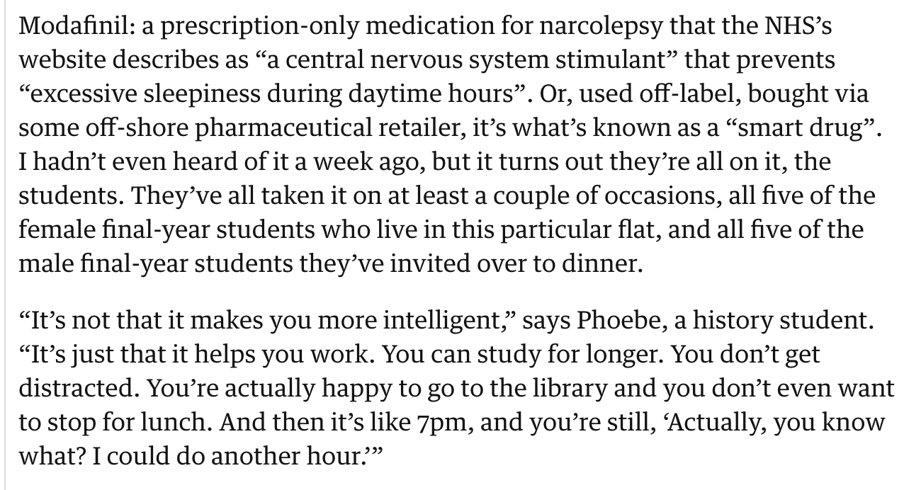
Quotas for Modafinil
Price
S
$50
D
100
Q
EC1101E, NUS, Spring 2020. Week 4. Guillem Riambau

Slide 158
Setting a quota: potential effects
Necessary good for those in medical treatments
Consumption / Enhancing Performance Drugs for others (e.g. seeking to improve grades)
Means to restrict use: Quota (Medical prescription)
https://www.theguardian.com/society/2015/feb/15/students-smart-drugs-higher-grades-adderall-modafinil
EC1101E, NUS, Spring 2020. Week 4. Guillem Riambau

Slide 159
Quotas for Modafinil
Price
S
$50
D
100
Q
EC1101E, NUS, Spring 2020. Week 4. Guillem Riambau

Slide 160
Quotas for Modafinil
Price
S
Suppose higher restriction to prescriptions, etc.
$50
D
100
Q
70
EC1101E, NUS, Spring 2020. Week 4. Guillem Riambau

Slide 161
Quotas for Modafinil
What is the effect for consumers?
What is the effect for producers?
EC1101E, NUS, Spring 2020. Week 4. Guillem Riambau

Slide 162
Quotas for Modafinil
Price
S
$50
To sell 70 units, sellers are willing to accept as little as $30….
$30
D
100
Q
70
EC1101E, NUS, Spring 2020. Week 4. Guillem Riambau

Slide 163
Quotas for Modafinil
Price
S
$90
$50
… but consumers are willing to pay as much as $90!!
$30
D
100
Q
70
EC1101E, NUS, Spring 2020. Week 4. Guillem Riambau

Slide 164
Quotas for Modafinil
Price
S
$90
$50
That’ll be the market price, of course
$30
D
100
Q
70
EC1101E, NUS, Spring 2020. Week 4. Guillem Riambau

Slide 165
Welfare effects: Quotas for Modafinil
P
S
$90
$50
$30
D
70
100
Q
EC1101E, NUS, Spring 2020. Week 4. Guillem Riambau

Slide 166
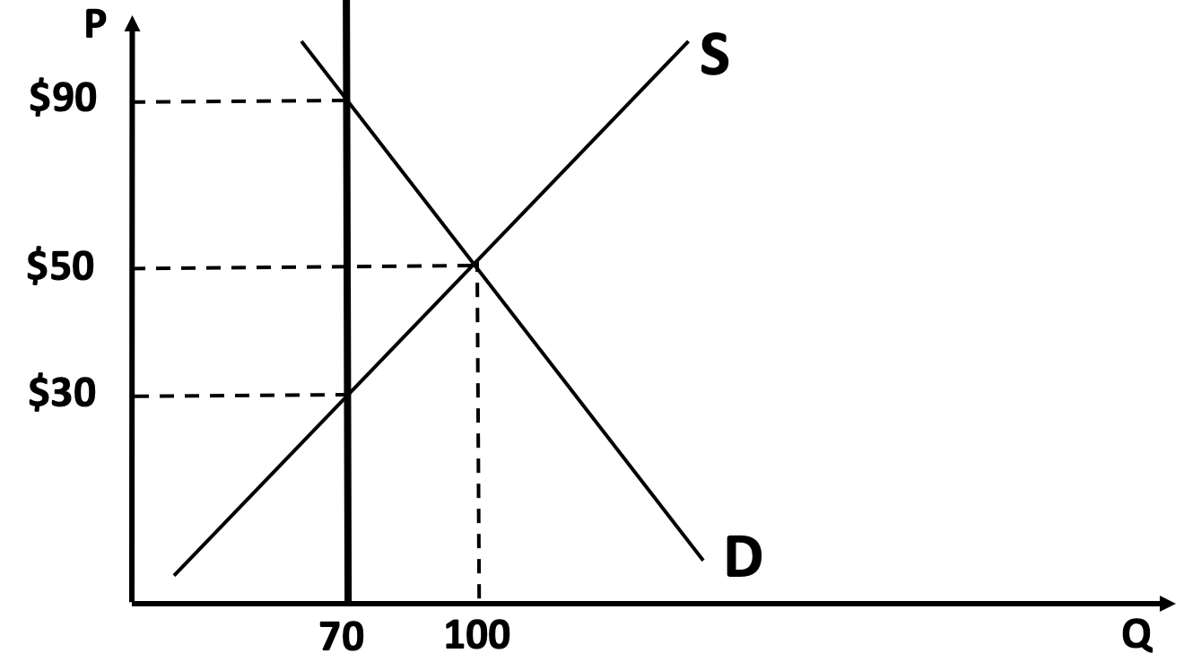
Welfare effects: Quotas for Modafinil
Before quota
After quota
EC1101E, NUS, Spring 2020. Week 4. Guillem Riambau

Slide 167
Welfare effects: Quotas for Modafinil
Before quota
After quota
EC1101E, NUS, Spring 2020. Week 4. Guillem Riambau

Slide 168
Welfare effects: Quotas for Modafinil
Before quota
After quota
CS
EC1101E, NUS, Spring 2020. Week 4. Guillem Riambau

Slide 169
Welfare effects: Quotas for Modafinil
Before quota
After quota
CS
PS
EC1101E, NUS, Spring 2020. Week 4. Guillem Riambau

Slide 170
Welfare effects: Quotas for Modafinil
Before quota
After quota
CS
CS
PS
EC1101E, NUS, Spring 2020. Week 4. Guillem Riambau

Slide 171
Welfare effects: Quotas for Modafinil
Before quota
After quota
CS
CS
PS
PS
EC1101E, NUS, Spring 2020. Week 4. Guillem Riambau

Slide 172
Welfare effects: Quotas for Modafinil
Before quota
After quota
CS
CS
PS
Deadweight Loss
PS
EC1101E, NUS, Spring 2020. Week 4. Guillem Riambau

Slide 173
Welfare effects: Quotas for Modafinil
Before quota
After quota
CS
CS
PS
Deadweight Loss
PS
Disclaimer: Deadweight Loss is a complex issue when public health is at stake. Consumption of drugs have certain negative externalities that make it optimal in fact that consumption is decreased (similar to loud music or cigarettes, for example). More on it, next week.
EC1101E, NUS, Spring 2020. Week 4. Guillem Riambau

Slide 174
Welfare effects: Quotas for Modafinil
Before quota
After quota
CS
CS
PS
Deadweight Loss
PS
(A quota on, say, kancong consumption, would result in a Deadweight Loss and everyone would agree. However, it is not truly a realistic policy.)
EC1101E, NUS, Spring 2020. Week 4. Guillem Riambau

Slide 175
Welfare effects: Quotas for Modafinil
Before quota
After quota
CS
CS
PS
Deadweight Loss
PS
EC1101E, NUS, Spring 2020. Week 4. Guillem Riambau

Slide 176
Welfare effects: Quotas for Modafinil
Before quota
After quota
CS
CS
PS
Deadweight Loss
PS
EC1101E, NUS, Spring 2020. Week 4. Guillem Riambau

Slide 177
Price ceiling
CS
CS
Deadweight Loss
PS
PS
Quotas are problematic
Black markets arise
They do not produce revenues like tax
(in fact, more police spending to prevent black markets)
EC1101E, NUS, Spring 2020. Week 4. Guillem Riambau

Slide 178
Remarks (1/5)
Taxes/Subsidies
On consumers
On sellers
Price limits
Price floor
Price ceiling
Quantity limits: quota
EC1101E, NUS, Spring 2020. Week 4. Guillem Riambau

Slide 179
Remarks (2/5)
Taxes/Subsidies
On consumers
On sellers
Price limits
Price floor
Price ceiling
Quantity limits: quota
It does not matter who nominally pays/gets them.
More inelastic side bears heavier burden with taxes (and gains more with subsidies)
EC1101E, NUS, Spring 2020. Week 4. Guillem Riambau

Slide 180
Remarks (3/5)
Taxes/Subsidies
On consumers
On sellers
Price limits
Price floor
Price ceiling
Quantity limits: quota
It does not matter who nominally pays/gets them.
More inelastic side bears heavier burden with taxes (and gains more with subsidies)
EC1101E, NUS, Spring 2020. Week 4. Guillem Riambau

Slide 181
Remarks (4/5)
Taxes/Subsidies
On consumers
On sellers
Price limits
Price floor
Price ceiling
Quantity limits: quota
Only matter when binding
EC1101E, NUS, Spring 2020. Week 4. Guillem Riambau

Slide 182
Remarks (5/5)
Taxes/Subsidies
On consumers
On sellers
Price limits
Price floor
Price ceiling
Quantity limits: quota
Less frequently used than taxes/subsidies
They generate no revenue
&
They incentivize black markets
EC1101E, NUS, Spring 2020. Week 4. Guillem Riambau

Slide 183
Remarks (Bonus)
Taxes/Subsidies
On consumers
On sellers
Price limits
Price floor
Price ceiling
Quantity limits: quota
In the absence of externalities, all of them produce a deadweight loss
EC1101E, NUS, Spring 2020. Week 4. Guillem Riambau

Slide 184
Next week
Market Failure & Perfectly Competitive Markets
Externalities; Public Goods and Common Resources
Profit Maximization; Perfect Competition
EC1101E, NUS, Spring 2020. Week 4. Guillem Riambau

Slide 185
KAHOOT!
https://play.kahoot.it/v2/?quizId=d5a66088-f0a1-49e3-a42a-11ec04a7462a
EC1101E, NUS, Spring 2020. Week 4. Guillem Riambau

